Slide 1
Deadlock and Starvation
Lecture 1 of 2
Introduction and Examples
Approaches to Dealing with Deadlock
  Ignorance
  Avoidance
Note: Examples of the concepts presented here can be found in the RTExamples folder: Q13
You are encouraged to open the project(s) in Visual Studio and run the program(s)
©Paul Davies 2020. Not to be copied, used, or revised without explicit written permission from the copyright owner. This lecture may contain animations and is best viewed as a slide show

Slide 2
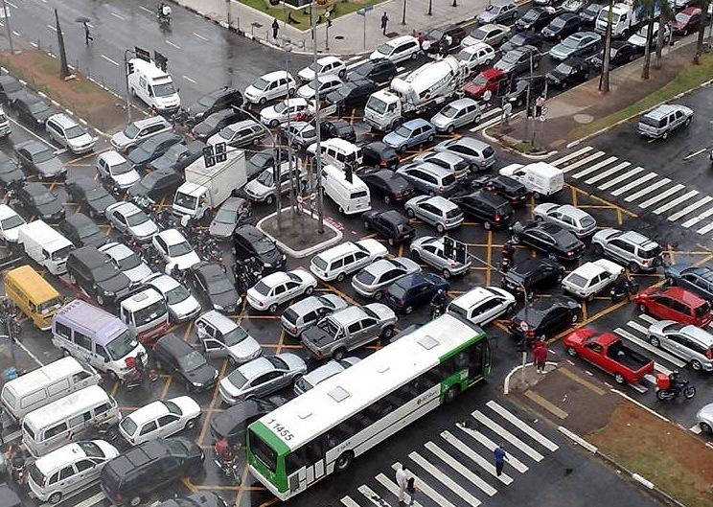
Deadlock in a Nutshell !!

Slide 3
Introduction
We know from discussions of mutual exclusion that computer systems are full of resources that can only be shared by one thread at a time.
Common examples include
  Printers
  Scanners
  Records in a Database
Such problems are generally solved using variations of a Mutex or Semaphore to protect the resource as we have seen previously.
However mutual exclusion on its own may not be enough, since there are many situations where a thread may actually need exclusive access not just to one resource, but perhaps to several resources simultaneously in order to carry out a task.
Such a situation can give rise to deadlock and/or starvation.

Slide 4


Example Deadlock Problem
Suppose threads A and B each require simultaneous access to a Scanner and a DVD-Writer in order to publish a document.
Suppose each resource is protected by its own mutex, ensuring single threaded access to that resource.
thread
A
thread
B
Scanner
Mutex
DVD-Writer
Mutex

Slide 5
Suppose each thread was coded by two independent programmers like this. Using this code could result in deadlock, i.e. nobody can go.
thread A acquires Scanner thread B acquires DVD-Writer
thread A thread B
if(…) if(…)
{ {
ScannerMutex.Wait() DVDMutex.Wait()
DVDMutex.Wait() ScannerMutex.Wait()
… …
… …
} }
thread A is blocked by B’s
acquisition of the DVD Writer
thread B is blocked by A’s
acquisition of the Scanner
Result : Possibility of deadlock depending upon timing of requests

Slide 6
Deadlock in Database Systems
The same problems can also arise in database systems where a thread may have to lock several records to prevent them being changed by other threads, while a decision on whether to update those records is performed, e.g. holding a Hotel and a Flight reservation simultaneously while confirming with a customer.
If thread A locks the Hotel record and thread B locks the Flight record and each thread then tries to lock the resource the other has locked, we end up with deadlock.
thread A acquires ‘Hotel’ thread B acquires ‘Flight’
thread A thread B
if(…) if(…)
{ {
Hotel.Lock() Flight.Lock()
Flight.Lock() Hotel.Lock()
… …
confirm bookings confirm bookings
… …
} }
thread A is blocked by B thread B is blocked by A

Slide 7
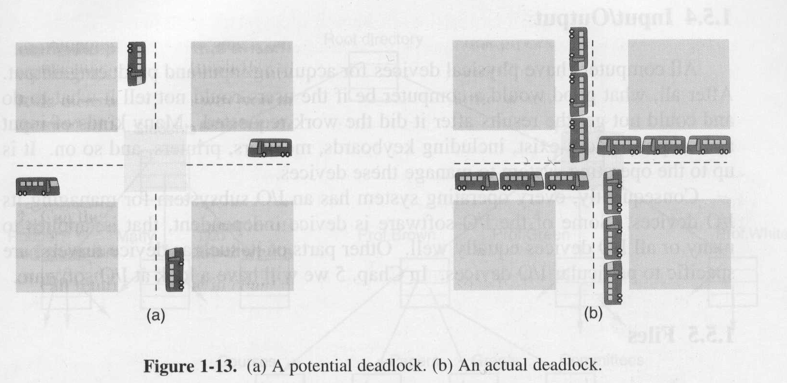
The potential for deadlock also arises on today’s overcrowded roads and is commonly referred to as gridlock. Here the resources we compete for are the 4 quadrants of an intersection when a vehicle enters them.
Note however, that just because the potential for deadlock exists, it does not mean that it will actually occur. If vehicles arrive at the intersection at different times, i.e. they do not compete to acquire the resources simultaneously, or do not wish to share the same quadrants, then deadlock will not occur.
However if vehicles arrive from all 4 directions and enter the intersection at pretty much exactly the same time, then deadlock could occur.
R1
R3
R2
R4
Potential for Deadlock
Actual Deadlock

Slide 8
Q: Why is deadlock not common at intersections?
What can a driver do to avoid deadlock and/or recover from it?
The advantage we as humans have, is that we can see the other users who are sharing our resources and avoid the problem. This is not possible for a thread, it is only aware of itself.
Let’s see if we can apply some of these ‘human’ solutions to solving software deadlock.
Enter the quadrant and if the next quadrant needed is occupied, then back up and leave the intersection (i.e. try to acquire all the resources sequentially, but be prepared to give them up).
Negotiate with other vehicles to take it in turns to enter the intersection (i.e. a 4 way stop), that is treat the 4 quadrants as one single resource rather than four separate resources.
Driver Over the vehicle that is blocking your progress.

Slide 9
Conditions required for Deadlock
Coffman and others showed in ‘71 that four conditions must exist for deadlock to occur amongst a set of threads trying to use any set of resources.
  At least one of the resources that the threads are trying to acquire must be non-sharable. That is, you cannot have deadlock if all the resources are sharable as this would mean that each thread would always be able to acquire the resources it needs without being blocked.
  (Question: you might ask why only one non-sharable resource is needed for deadlock to be a possibility, isn’t two the minimum? This is because, a thread could deadlock itself if it requests use of the same non-sharable resource more than once. This is something a Mutex helps prevent but a Semaphore doesn’t).
  Pre-emption of the resource is not possible, that is, once a resource has been given to a thread, it cannot be forcibly taken back.
  (If a resource could be taken back from the thread that has acquired it, then it might avoid deadlock but could introduce starvation.)

Slide 10
  One thread must be holding at least one resource while requesting use of another, held by a second thread.
  There exists, at the moment deadlock actually occurs, a circular wait dependency between the threads and resources they are requesting.
  That is, your thread must be waiting for a resource held by another thread which is waiting for a resource held by another, ……, which is waiting for a resource held by you.
  That is everybody is waiting for somebody else to give up a resource before anyone can proceed.

Slide 11
Holt showed in ‘72 that these four conditions can be modelled using a directed graph and used to determine if deadlock has actually arisen in a system.
Such a graph has two elements
  Threads shown as circles.
  Resources shown as rectangles.
For example, the illustration opposite shows three threads T₁, T₂ and T₃ and four resource types, R₁, R₂, R₃ and R₄.
The small dot within the resource rectangle shows how many instances of that resource exist.
From the diagram opposite, we see that there is just one instance of the resources R₁ and R₃ but there are two instances of R₂ and three instances of R₄.
One instance of R₁
R₁
R₃
T₁
T₂
T₃
R₂
R₄
Three instances of R₄

Slide 12
Referring to the arrows in the diagram we see:
  T₁ has been allocated an instance of R₂ and is requesting an instance of R₁ but it is blocked as the single resource has been allocated to T₂.
  T₂ has been allocated an instance of R₁ and R₂. The latter is not blocked by T₁ because there are two instances of R₂. It is also requesting an instance of R₃ and is blocked as this has been allocated to T₃.
  T₃ has been allocated an instance of R₃ and is requesting nothing.
  No instances of R₄ have been requested or allocated.
We show these dependencies using the example notation below
  R₂ T₁ R₁ T₂ R₃ T₃
  R₂
T₂ requesting an allocation or instance of R₃
R₁
R₃
T₁
T₂
T₃
R₂
R₄
instances of R₂ allocated to T₁ and T₂

Slide 13
Such graphs could be maintained by an operating system as a kind of linked list data structure to detect deadlock at run time.
How do we tell if deadlock has occurred? Deadlock exists when a circular dependency has formed in the resource allocation graph.
In the example opposite, deadlock has NOT yet occurred, since even though
  T₃ is blocking T₂’s request for R₃ and
  T₂ is blocking T₁’s request for R₁
T₃ can release R₃ when it has finished with it which will allow T₂ to acquire it, complete its task and release its instances of R₃ , R₂ and R₁ allowing T₁ to eventually acquire R₁
In other words there is no circular dependency, since everyone can eventually get the resources each needs to complete.
T₃ is blocking T₂’s request for R₃
R₁
R₃
T₁
T₂
T₃
T₂ is blocking T₁’s request for R₁
R₂
R₄

Slide 14
What if T₃ now tries to acquire an R₂?
All instances of R₂ have been allocated. It follows that all threads are now deadlocked as there are in fact two circular dependencies arising as shown below
R₂ T₁ R₁ T₂ R₃ T₃
R₂
That is, T₁ owns an R₂ and is requesting an R₁ which has been given to T₂ which in turn is requesting R₃ which has been given to T₃ which is requesting an R₂ which have both been given to T₁ and T₂ (i.e. there are no R₂’s left)
R₁
R₃
T₁
T₂
T₃
T₃ makes a request for R₂ creating deadlock
R₂
R₄
When T₃ request the R₂,
deadlock will occur

Slide 15
In general there are 4 solutions to dealing with Deadlock
  Ignorance: Ignore the problem altogether - not as daft as it sounds !!
  (This solution is always possible but doesn’t solve the problem !!)
  Avoidance: Anticipate that deadlock could arise and avoid it by carefully writing the threads to request the resources in a particular order. (Not always possible unless the program developers know about each other and the resources that each might acquire.)
  Detection and Recovery: Acknowledge that deadlocks can occur outside of your control. Detect when they happen and take action to recover. (Needs the help of the OS which is not always possible)
  Prevention: By employing resource allocation algorithms at run-time we make sure that the system never gets into a situation where deadlock can arise (Needs the help of the operating system and the programmer which is not always possible).
Thus there is no guaranteed solution to deadlock, each set of circumstances needs to be treated differently and any such solution may give rise to starvation (meaning the thread may never get all the resources it needs to complete its task).

Slide 16
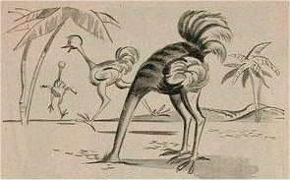
Strategy 1 - Ignoring Deadlock: The Ostrich Algorithm
The simplest approach to dealing with deadlock is to ignore it, i.e.
“bury your head in the sand like an Ostrich and
pretend it isn’t happening”.
Different people react differently to this strategy.
  If you are a Computer Scientist or Mathematician you would find this solution totally unacceptable and would probably explore all avenues in your attempt to come up with a solution regardless of cost, effort and time.
  However, if you are an Engineer, you might take a more pragmatic view and conclude that if deadlocks are only occurring in practice once every 3 months, then it is probably not worth spending too much time, effort and money trying to solve the problem as there are more important bugs to solve elsewhere.
Deadlock – What Deadlock?
See Q13 – DeadlockandStarvation in RTExamples Folder

Slide 17
Strategy 2 - Deadlock Avoidance: Solution 1 – Resource Request Ordering
Write all your programs such that they attempt to acquire multiple resources in the same strict order, as shown below
thread A thread B
while(1) while(1)
{ {
ScannerMutex.Wait() ScannerMutex.Wait()
DVDMutex.Wait() DVDMutex.Wait()
… …
ScannerMutex.Signal() ScannerMutex.Signal()
DVDMutex.Signal() DVDMutex.Signal()
} }
This works because it’s not possible for both threads to simultaneously be holding one of the resources it needs while being blocked on the other. For example thread A cannot be holding the Scanner while thread B is holding the DVD writer, so no circular queue can form – hence no deadlock is possible.
In Practice
This solution requires that the designers of each thread agree that they will all attempt to acquire their resources in an agreed order. This approach is only practical where the designers of the threads are aware that other may be using the same resources and thus has to consult with them to agree an order.
See Q13 – DeadlockandStarvation project “Specific Ordering”

Slide 18
Strategy 2 - Deadlock Avoidance: Solution 2 – Give up Resources
Get a blocked thread to give up whatever resources it has acquired, should it fail to acquire all the resources it needs within a specified time-out period.
thread A
while(1) { // try to acquire both resources
ScannerMutex.Wait() ; // gain access to 1st resource
if( DVDWriter.Wait (1000 ) == WAIT_TIMEOUT) // if cannot get 2nd resource within 1000 mS
{ ScannerMutex.Signal() ; // give up 1st resource
SLEEP(2000) ; // wait 2 seconds
continue; // try to acquire them again
}
. . . // got both resources so use them
. . .
}
In Practice
The problem with this solution is one of starvation. If a thread gives up any resources it has already acquired, there is no guarantee it will ever get any of them back, if another thread acquires them in between.
See Q13 – DeadlockandStarvation project “Relinquish Resource”

Slide 19
Strategy 2 - Deadlock Avoidance: Solution 3 - Treat Multiple Resources as One
Treat multiple resources as one single resource and protect with one Mutex.
Now, a thread either acquires all ‘n’ resources with a Wait() on a single mutext or it acquires none of them.
In Practice
It requires co-operation between all the threads using the resources.
Other threads unknown to the designer cannot be allowed to acquire a sub-set of those resources using separate Mutexes.
For example, to avoid deadlock using this scheme imagine two threads A and B that require 5 resources simultaneously : R₁-R₅.
If we create a single Mutex to cover all 5 resources and allow A and B to perform Wait() and Signal() operations on that single Mutex, we can avoid deadlock and starvation, but it means that a 3rd thread C cannot acquire an individual resource such as R₂ or R₄ without blocking threads A and B.
Furthermore, why should C be forced to acquire resources R₁-R₅ when it is only interested in using say R₂ or R₄?

